Slide 1
HR ANALYTICS
Namitha P Shaji

Slide 2
Introduction
Power BI is a powerful business analytics tool that allows users to visualize and share insights from their data. It enables the creation of interactive dashboards and reports, making it easier to analyze trends, track performance, and make data-driven decisions.
It connects to a wide range of data sources such as Excel, databases, cloud services, and web APIs. Also Power BI supports real-time data monitoring and updating of dashboards.

Slide 3
Project Overview
The Human Resource Report provides a comprehensive view of employee data across various departments and business units. Its primary purpose is to support HR decision-making by offering insights into workforce demographics, job classifications, job satisfaction, performance ratings, and other key metrics.
Key Objectives includes tracking employee attributes like age, gender, education level, and job type to understand the organization’s demographic composition, evaluating employee job satisfaction and involvement.

Slide 4


Technologies Used

Slide 5
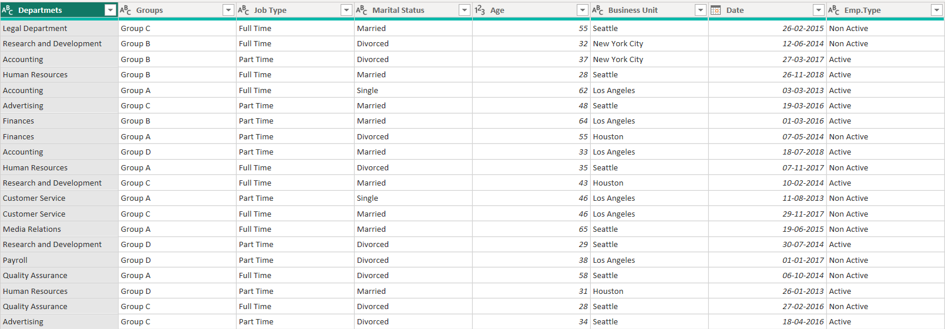
DATASET
Corporate Service Company Data.
22 Columns and 3520 rows.
Key data fields:
Departments, Business Units, Hire date, Employee education, Job satisfaction, Salary, Age, Gender etc.
Data Transformation was done using Power Query.

Slide 6

Dashboard Overview
DAX Measures
Key Observations
Future Enhancement

Slide 7
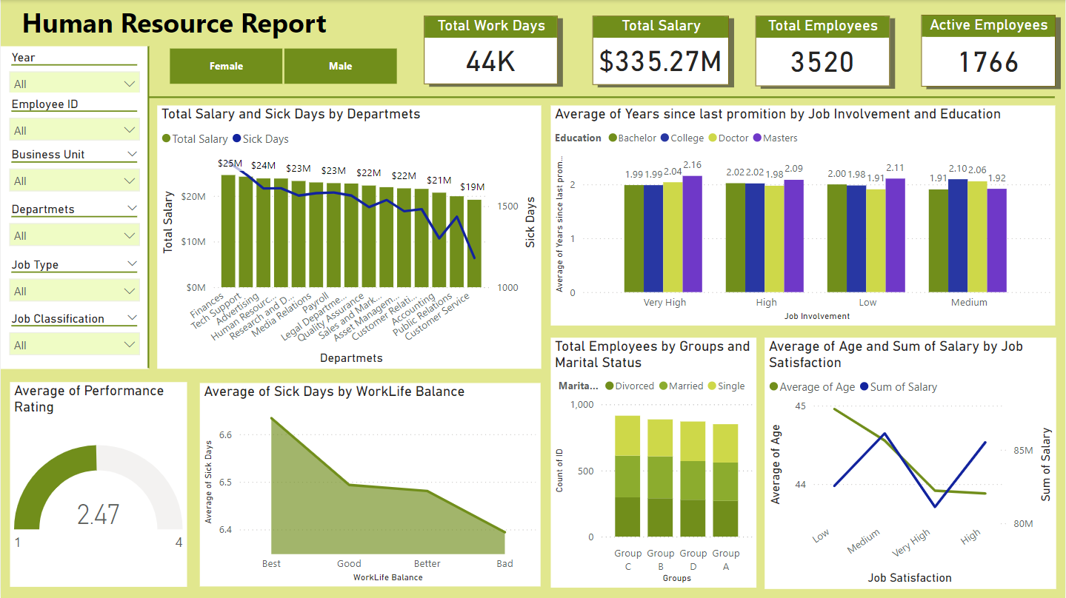

Slide 8
DAX Measures
DAX is a formula language used in Power BI to perform data manipulation and analysis. It allows users to create powerful data insights and perform complex calculations, such as aggregations, time-based analysis, and conditional logic.
Total Active Employees = CALCULATE([Total Employees],'Human Resources'[Emp.Type]="Active")
Total Balance Days = SUM('Human-Resources'[Balance Days])
Total Employees = COUNTROWS('Human-Resources’)
Total Salary Cost = SUM('Human-Resources' [Salary])
Total Sick Days = SUM('Human-Resources' [Sick Days])

Slide 9

Observations

Slide 10
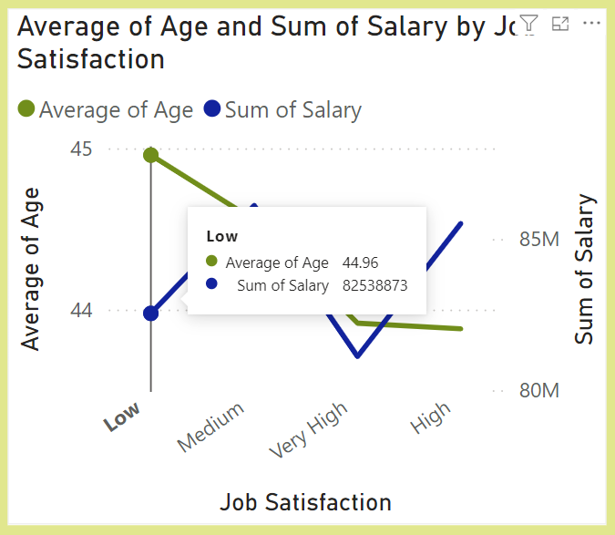
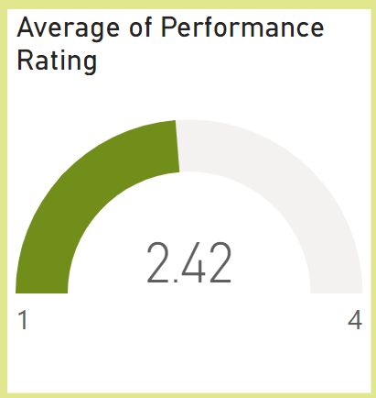
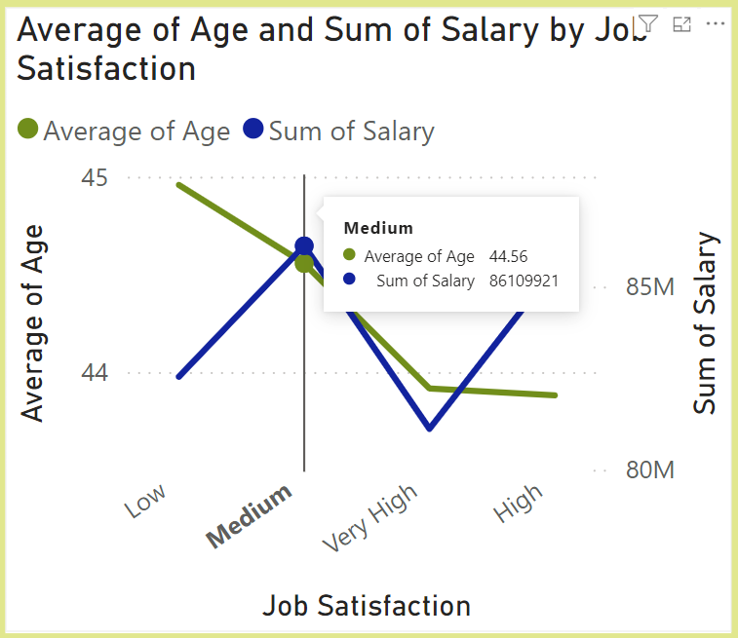
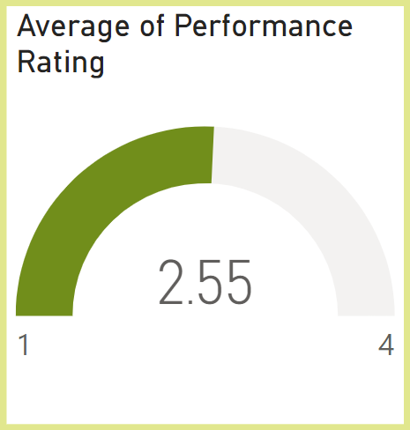
OBSERVATION: As job satisfaction increases average performance rate also increases.

Slide 11
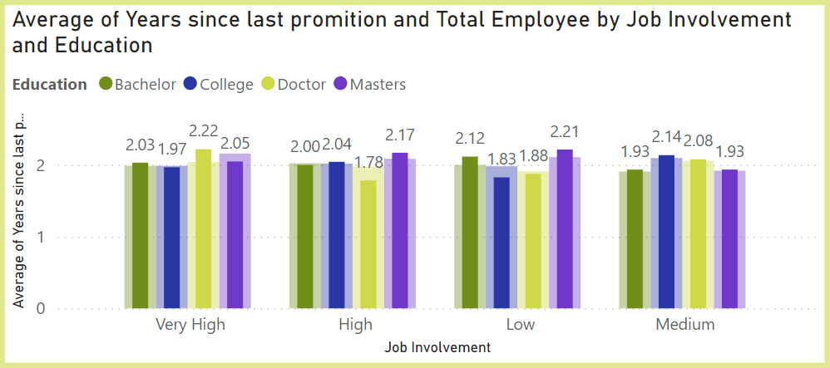
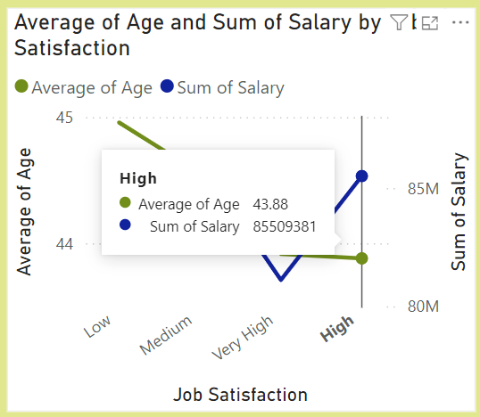
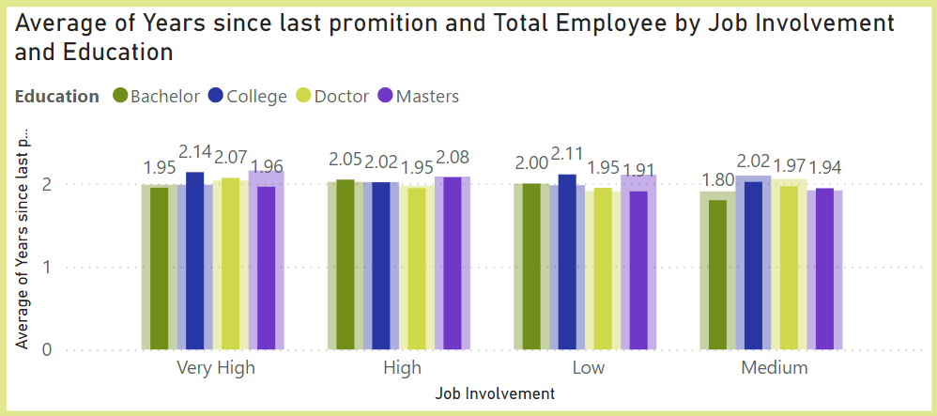
OBSERVATION:
Considering an average elder employee with a doctorate degree, It tend to have a frequent promotion for those who has higher job involvement than an average younger employee.
While an average younger employee with a bachelors degree tend to get a frequent promotion when he possess a medium job involvement.

Slide 12
Comparing 2013 V/S 2018 Data
The Total Salary spend on Employees has increased from $52.93M to $59.12M. (11.69% increase)
Average performance rating increased from 2.47 to 2.53
In 2013, Human Resource was the department getting highest total salary($4.87M) with 52 employees.
In 2018, Advertising became the most paid department($4.81M) with 51 employees.
In 2013, younger employees were paid the least salary. In contrast the highest paid in 2018 were the youngest employees.
Group B had the most hirings in 2013. In contrast it was the least hired group in 2018.

Slide 13
Few Suggestions
Increasing salary of elder employees will increase the performance rating.
Hiring more freshers is profitable to the company since they show higher job satisfaction with the least salary hike and possess a medium level of job involvement.

Slide 14
Thank you

